Slide 1
W251 Final Project
Music Generation GAN
Jorge Hernandez, Tom Nguyen, Luke Verdi, Hao Wu

Slide 2
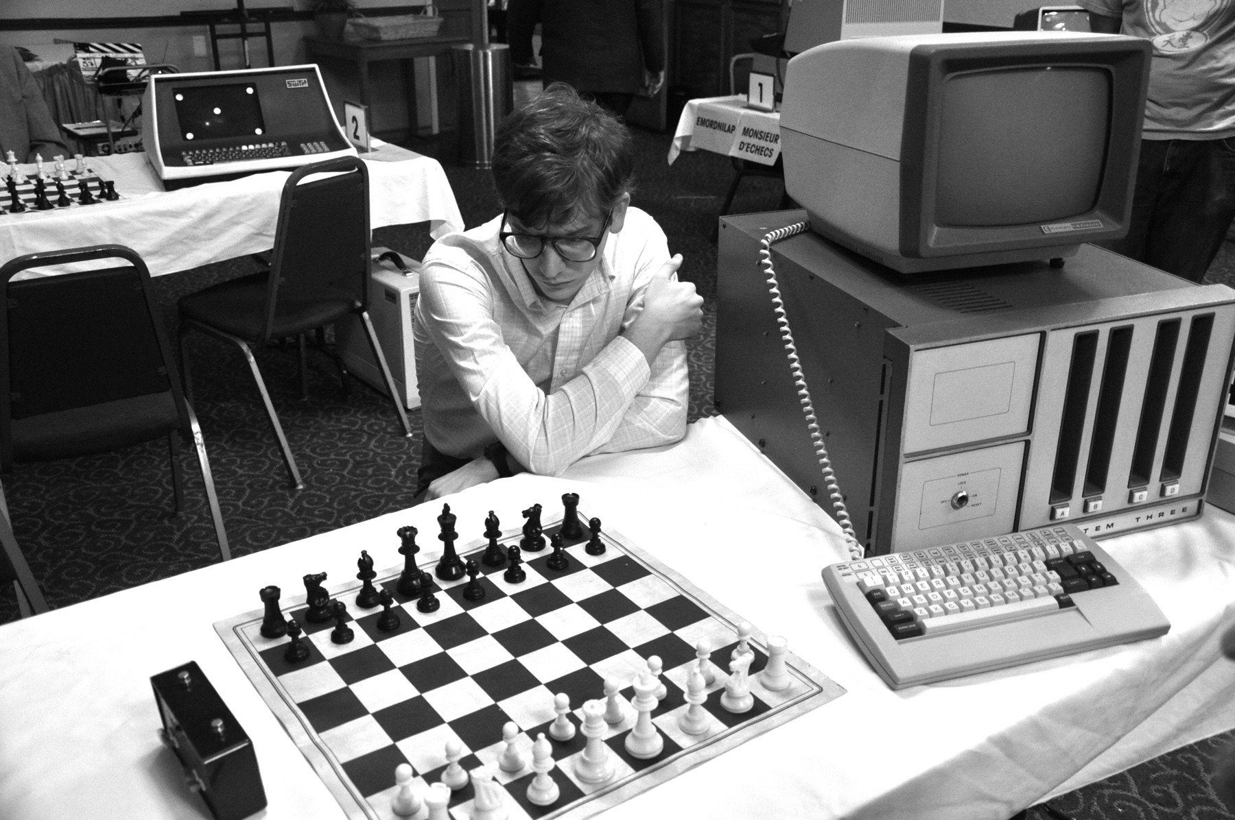
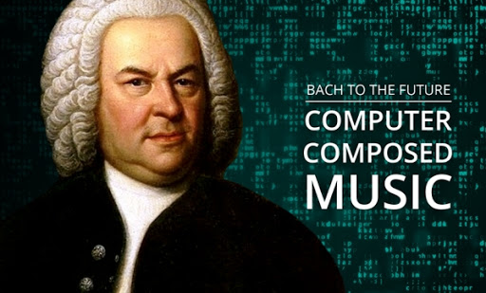
Automating music generation has proved much more difficult than automating tasks like chess
What makes a “winning” composition is much less clear, and the rules are meant to be played with
Notes:
Left: https://medium.com/@gluehuff/computer-chess-and-how-it-works-e3aea346d757
Right: http://sonatica.fm/blog/item/11-bach-to-the-future-computer-generated-musical-compositions
Mention how making music has been pursued for just as long, but unlike games such as Go or Chess where there are clear rules, and a probability of winning that can be optimized, music is more subjective, and often meant to slightly break the “rules.”
Mention Beethoven’s 1st symphony beginning on a dissonant note as an example.

Slide 3
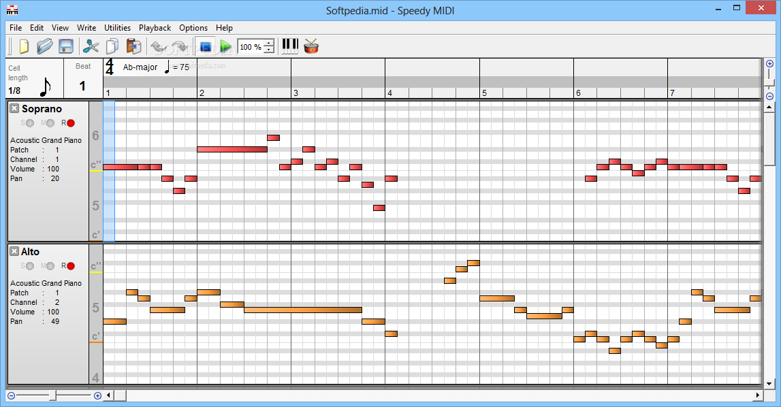
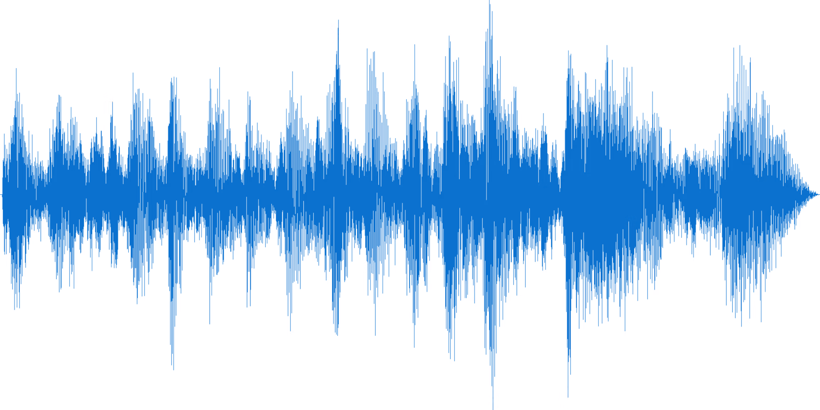
Successful AI algorithms tend to work with midi files instead of a direct audio waveform
Waveforms have >2.5 million timesteps per minute; Midi files represent an abstraction of notes played
Notes:
Left: https://cloudinary.com/blog/how_to_generate_waveform_images_from_audio_files
Right: https://www.softpedia.com/get/Multimedia/Audio/Audio-Editors-Recorders/Speedy-MIDI.shtml
Mention how recent algorithms are getting to the point of generating waveforms (like what you would hear for an .mp3), but we’ve decided to work with midi files since this is a helpful mathematical notation of what’s played, for how long, dynamics, timing, pedals, etc.

Slide 4


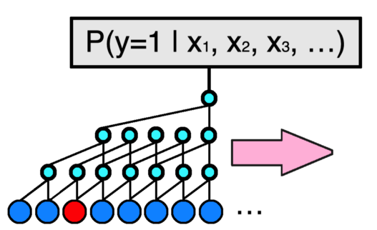
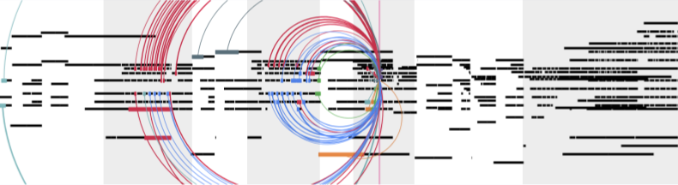
Typical approaches involve RNNs, LSTMs, modified Transformers or CNNs
These approaches usually generate one note at a time, using past notes for prediction
Notes:
Top Left: https://magenta.tensorflow.org/2016/06/10/recurrent-neural-network-generation-tutorial
Bottom Left: https://towardsdatascience.com/generating-piano-music-with-dilated-convolutional-neural-networks-d81d02e1dda6
Right (both): https://magenta.tensorflow.org/music-transformer
Explain how all work. RNNs/LSTMs struggle with long term structure; Some CNNs/Transformers are able to generate coherent pieces

Slide 5


But what about viewing a piece of music as an image, and using a GAN to generate a large section at once?
Some exploration in this area can generate coherent segments of music, but not very long
Notes:
Left: https://magenta.tensorflow.org/music-transformer
Right: https://thispersondoesnotexist.com/
We don’t need to compose linearly - often composition doesn’t happen like that and is working with a sheet of music, starting with a vague structure (maybe ABA, maybe verse, verse, chorus, verse, bridge, chorus, etc.) putting melodies and variations here and there, and filing in with transitions and harmonies

Slide 6

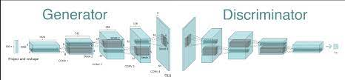
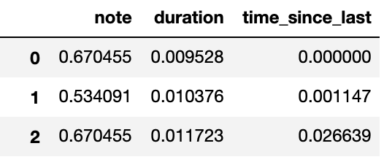
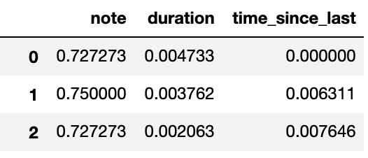
We tried to developed a denser midi representation, then use a GAN to generate new images/pieces
We can condense ~20 seconds of piano music into 700-1000 values, something like a 32x24 “image”
If this is possible, then scaling to even only a 256x192 “image” is symphony with full orchestra
Notes:
Top Left: https://magenta.tensorflow.org/music-transformer
Middle bottom: https://gluon.mxnet.io/chapter14_generative-adversarial-networks/dcgan.html
Rest: Us, Us, GarageBand/Us
We decided to try to take a homerun effort here, or developing a dense representation of music, trying to generate this with a GAN and then parsing back into a Midi file which we could play.
If this works, we could then scale this to a larger image with more voices, more features (dynamics) and a longer length, which would be a very complex piece of music.

Slide 7
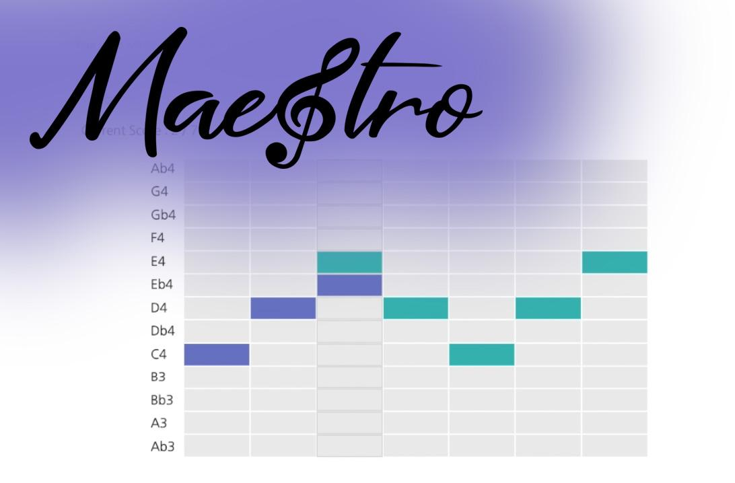
MIDI and Audio Edited for
Synchronous TRacks and Organizations
A collection of 200 hours of paired audio and MIDI recordings from ten years of International Piano-e-Competition.
Made available by Google since 2018.

Slide 8
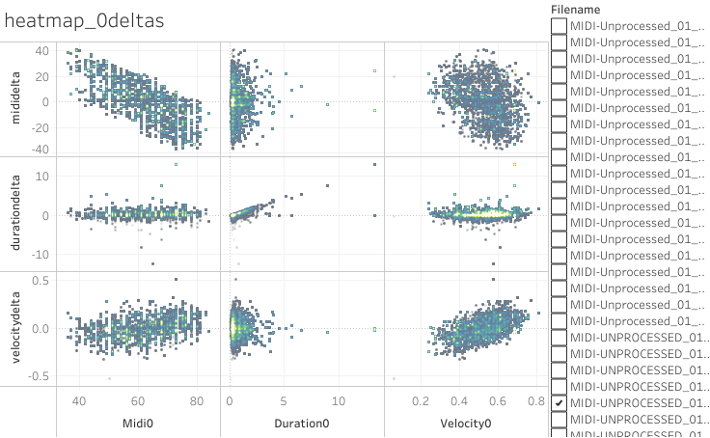
MAESTRO DATASET V3.0.0
1277 MIDI songs of virtuoso piano are processed into 2 Training Datasets. 15K songs and 200K songs
Notes:
https://public.tableau.com/views/MaestroMIDIDataset/heatmap_0deltas?:embed=y&:display_count=y&:showVizHome=no

Slide 9
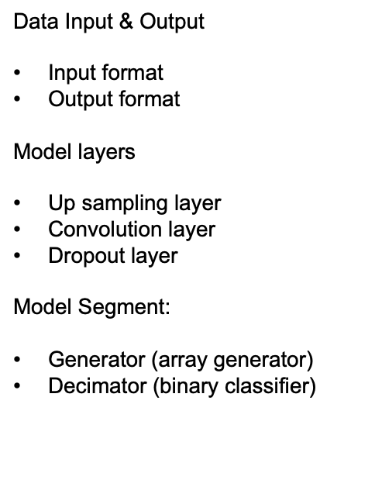
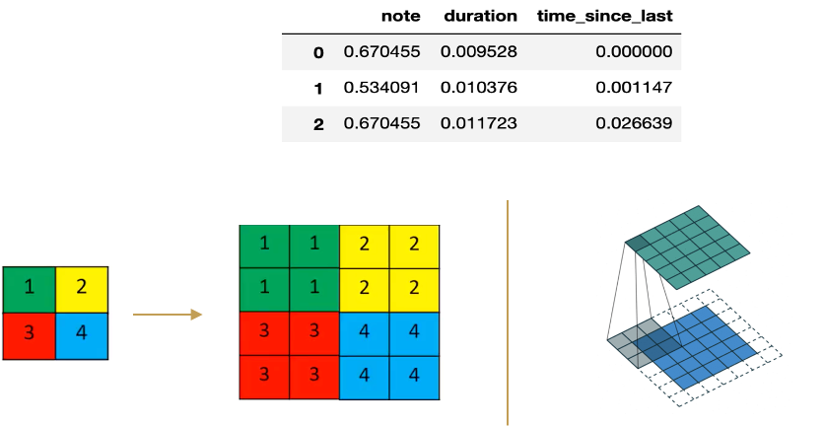

Slide 10
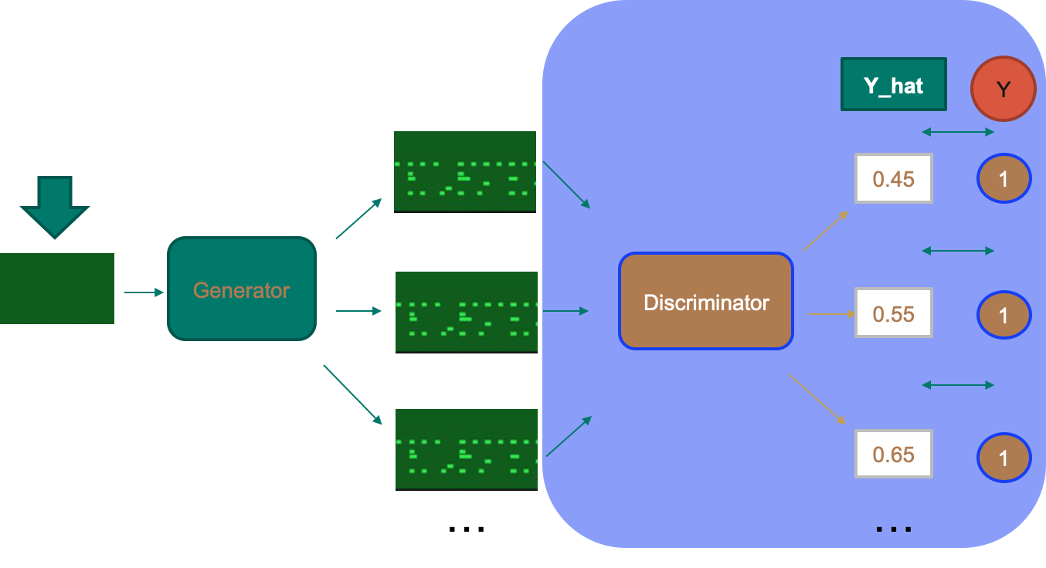


Slide 11
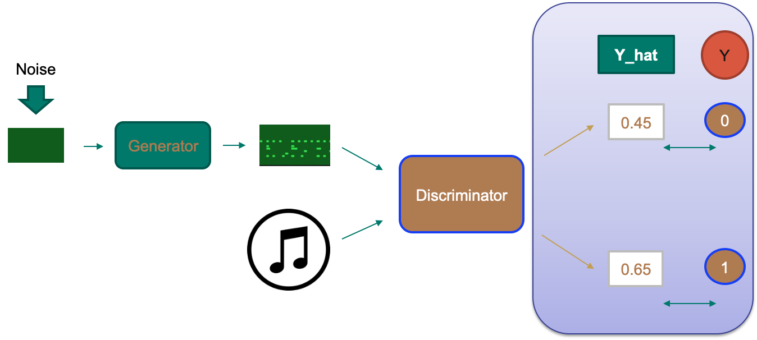

Slide 12
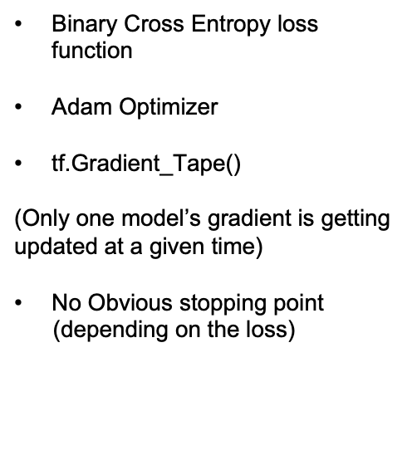
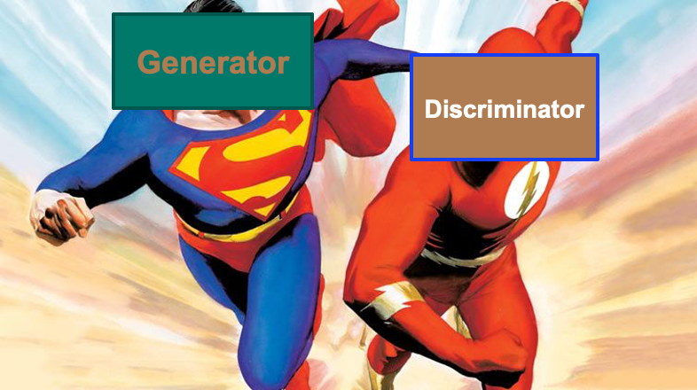

Slide 13
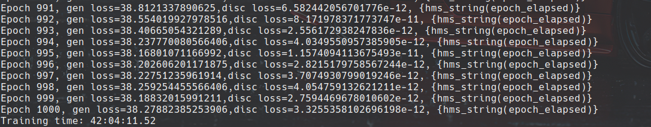
Training in the Cloud
Trained our model on the 15,000 parsed midi files for 2000 epoch - 24 hours
Trained another model on 200,000 parsed midi files for 1000 epoch - 42 hours

Slide 14
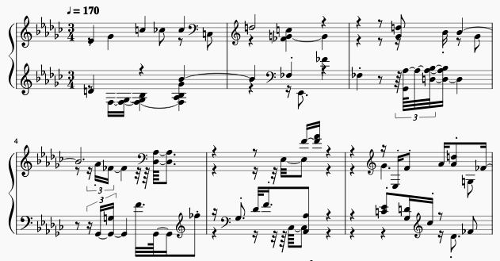

Model Outputs
Notes:
Our model outputs never seemed to pick up all the info needed to make a successful composition. In the sheet music for one of our songs generated, you can see there are many accidentals, as if the model is not learning key signatures. And the notes aren’t appearing on downbeats in measures 4-6, which would be relatively rare in classical composition.

Slide 15

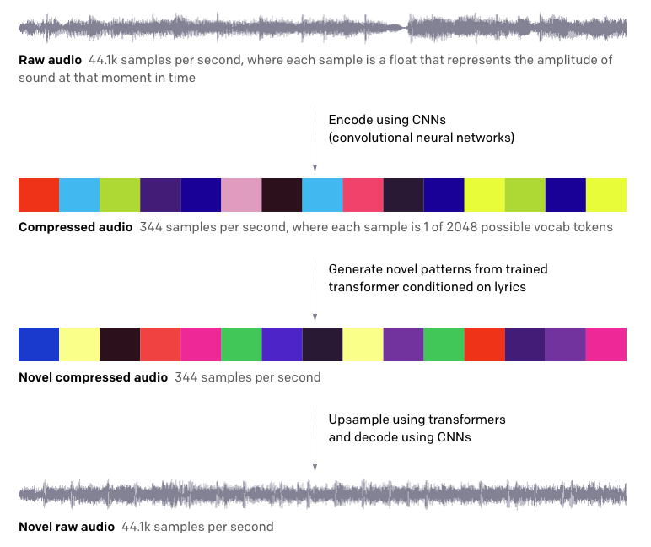
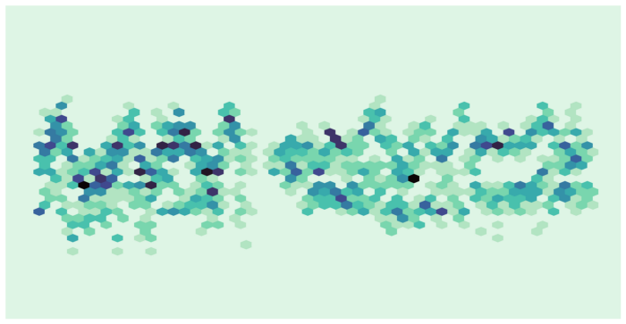
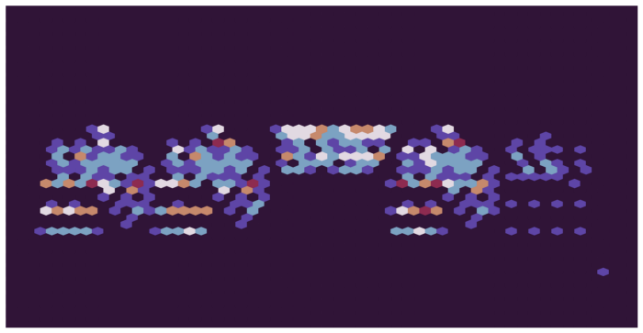

If we had more time, we’d have new algorithms for the compression and upsampling:
Midi File
Encoded Image Representation of Midi file
Generated Image
Upsampled Midi
Notes:
Left: https://openai.com/blog/jukebox/
Right: https://towardsdatascience.com/visualizing-musical-performance-5da28b96957a
We tried to do the compression and decompression ourselves, but this obviously didn’t work...however, there is a precedent for taking time series data, compressing, generating and then upsampling to something useful. But the encoding and upsampling happen with a model, which we didn’t have. So with midi files that might look something like this, where we’ve lost information going to the encoded image, and then use another model to add information and go from the generated image to the upsampled midi.

Slide 16
Thank You
Any Questions??
Note: We had too many references to fit neatly on a slide, so references are listed in the notes of each slide throughout the presentation where appropriate

